Slide 1
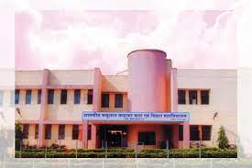
GOVT. CHANDULAL CHANDRAKAR PG COLLEGE PATAN
COMPARISON BETWEEN HUMAN AND COMPUTER LANGAGES
GUIDED BY
NIDHI SINGH THAKUR
SUBMITED BY
PALLAVI

Slide 2
CONTENT :-
HUMAN LANGUAGE
COMPUTER LANGUAGE
TYPE OF COMPUTER LANGUAG
CONCLUSION

Slide 3
HUMAN Language
Commonly used to express Feeing and understand other person expression. It can be oral or gestural kind of Communication

Slide 4
Computer language
A computer language is an artificial language designed to work for different applications in different environments.

Slide 5
Computer Languages
Low Level Language
Machine Language
Assembly Language
High Level Language
Example:-
C
c++
Java
Phython
PHP
Pascal,etc.
TYPE OF COMPUTER LANGUAGES

Slide 6
Conclusion :-
Human language and computer language are two
distinct forms of communication that serve different purposes.

Slide 7
Thank You

